Slide 1

Exploratory data analysis
by Priyanka Verma

Slide 2
What is eda ?
“ EDA is an approach for data analysis using variety of techniques to gain insight about the data.”

Slide 3
Importance of EDA
Improve understanding of variables by extracting averages by mean, minimum ,and maximum values etc.
Discover errors , outliers and missing values in the data.
Identify patterns by visualizing data in graphs such as bar graph, scatter plots , heatmaps and histograms.

Slide 4
Basic steps in any EDA
Cleaning and preprocessing
Statistical Analysis
Visualization for trend analysis, anomaly detection (and
removal).

Slide 5
EDA using Pandas
Import data into workplace( Jupyter notebook, Google colab,Python IDE)
Descriptive statistics
Removal of nulls
Visualization

Slide 6
1. Packages and data import :-
Step 1 | Import Pandas to the workplace. “ import pandas as pd”
Step 2 | Read dataset into Pandas dataframe. Different input formats include: Excel : read_excel CSV : read_csv JSON : read_json HTML and many more

Slide 7
2. Descriptive Stats(Pandas)
 | Used to make preliminary assessment about the population distribution of the variables.
 | Commonly used statistics:
1. | Central Tendency: Mean – The average value of all the data points : dataframe.mean() Median- The middle value when all the datapoints are put in an ordered list : dataframe.median() Mode : The datapoints which occurs the most in the dataset : dataframe.mode()
2. | Spread : It is the measure of how far the datapoints are away from the mean or median. Variance – The variance is the mean of the squares of the indivisual deviations – dataframe.var() Standard deviation – The standard deviation is the square root of the variance- dataframe.std()
3. | Skewness: It is a measure of asymmetry : dataframe.skew()

Slide 8
3. Null Values
Detecting
Detecting Null – values: Isnull() : it is used as an alias foe dataframe.isna(). This function returns the dataframe with Boolean values indicating missing values. Syntax : dataframe .isnull()
Handling
Handling null values : Dropping the rows with null values: dropna() function is used to deleate rows and columns with null values. Replacing missing values : fillna() function is used fill missing values with a special values like mean or median.

Slide 9
4. Visualization
Univariate Analysis
Multivariate Analysis
Looking at one variable /column at a time
Bar graph
Histograms
Boxplot
Looking at releationship between two or more variables
Scatter plots
Pie plots
Heatmaps(seaborn)

Slide 10
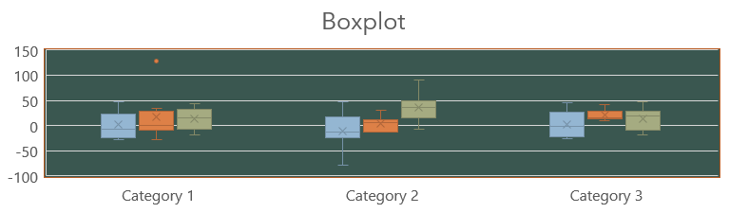
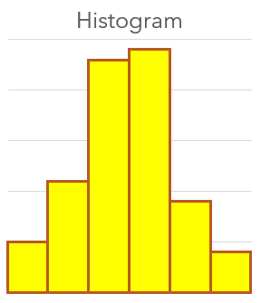
BarGRAPH, Histogram and Boxplot Bar graph: A bar plot is a plot that presents data with rectangular bars with lengths proportional to the values that they represent. Boxplot: Depicts numerical data graphically through their quantiles. The box extends from the Q1 to Q3 quartile values of the data, with a line at the median(Q2). Histogram: A histogram is a representation of the distribution of the data.

Slide 11
Scatterplot ,Pie plot
Scatterplot: Shows the data as a collection of points.
Dataframe.plot.scatter(x=‘x column name’, y=‘y column name’)
,
Pieplot: Proportional representation of numerical data in a column.
Dataframe.plot.pie(y=‘column name’)

Slide 12
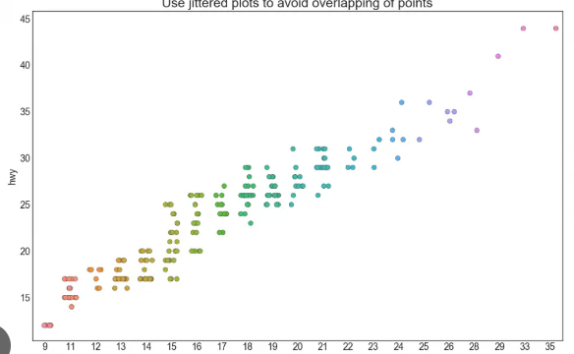
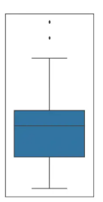
Outlier Detection outlier is a point or set of the data points that lie away from the rest of the data values of the dataset.
For ex:- In boxplot ,the data points which lie outside the upper and lower bound can be considered as outliers
In a scatterplot ,the data points which lie outside the groups of datapoints can be considered as outliers

Slide 13
Outlier Removal:-
Calculate the IQR as follows:
Calculate the first and third quartile(Q1 and Q3)
Calculate the interquartile range,IQR = Q3-Q1
Find the lower bound which is Q1 * 1.5
Find the upper bound which is Q3 * 1.5
Replace the data points which lie outside this range.
They can be replaced by mean or median.

Slide 14
After EDA
Confirmatory Data Analysis: Verify the hypothesis by statistical analysis.
Get conclusions and present your results nicely.

Slide 15
THANK YOU

